Slide 1

Capstone Project: Training an AI Agent to Play Flappy Bird
Presenter: Ruben Valenzuela

Slide 2

Section 1
The Game Environment

Slide 3

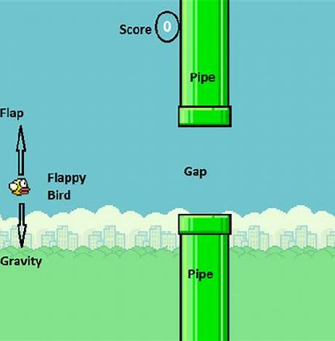
Page 1.1: Game Overview
Game Mechanics Overview
Flappy Bird's gameplay mechanics emphasize timing and precision, requiring players to master the rhythm of tapping to navigate through obstacles, which serves as a foundational aspect for developing AI strategies in reinforcement learning.

Slide 4



Page 1.2: Tools and Libraries
PLE Framework Benefits
01
The PyGame Learning Environment streamlines reinforcement learning implementation, allowing developers to concentrate on algorithm development while managing game dynamics efficiently through its user-friendly interface.
OpenCV enhances the AI agent's visual processing capabilities, enabling effective feature extraction and real-time image manipulation, which are crucial for accurate decision-making in dynamic gaming scenarios.
02
OpenCV's Role in AI

Slide 5
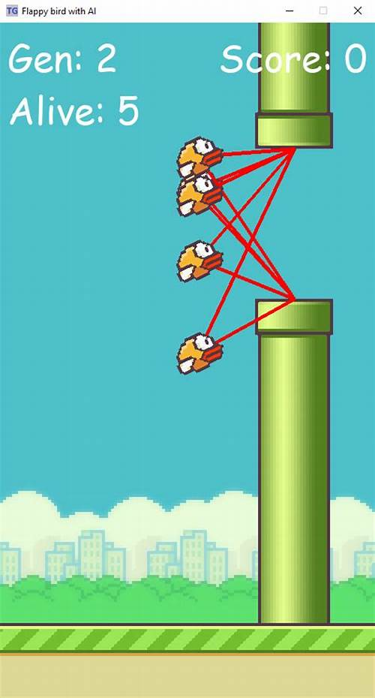
Page 1.3: Game Setup for AI Interaction
Action Space Simplification
A binary action space streamlines the learning process, focusing on essential gameplay decisions.
State Representation Importance
Reward System Design
Effective state representation is vital for the AI's understanding of game dynamics and decision-making.
A well-structured reward system accelerates learning by reinforcing positive actions and penalizing mistakes.

Slide 6
Section 2
The Pre-trained Model

Slide 7

Page 2.1: Understanding Transfer Learning
01
02
03
Knowledge Reusability
Hierarchical Feature Learning
Efficiency in Training
Transfer learning enables the application of learned features from one task to another, enhancing model performance with limited data availability.
Pre-trained models capture complex data representations, allowing for effective feature extraction that can be fine-tuned for specific applications.
Utilizing transfer learning reduces training time and resource requirements, facilitating faster development cycles for AI models in various domains.

Slide 8
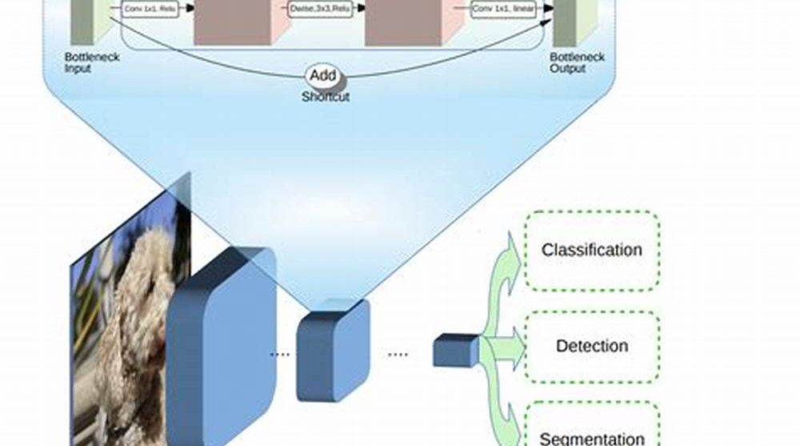
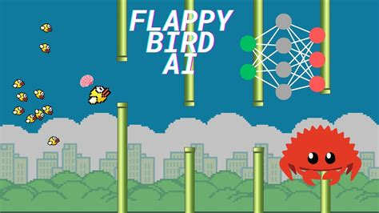
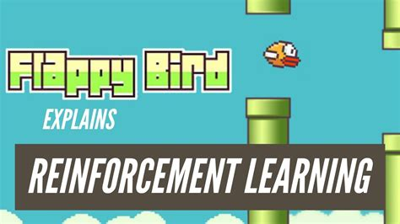

Page 2.2: Chosen Model
Model Efficiency and Speed
Advanced Feature Extraction
Adaptability for Reinforcement Learning
MobileNetV2's architecture is optimized for rapid inference, making it ideal for real-time applications like Flappy Bird, where quick decision-making is essential for gameplay success.
The model's depthwise separable convolutions enhance its ability to extract relevant features from the game's visuals, improving the AI's understanding of the environment and gameplay dynamics.
MobileNetV2's design allows for seamless integration with reinforcement learning frameworks, facilitating the adaptation of pre-trained features to the specific challenges presented by the Flappy Bird game.

Slide 9
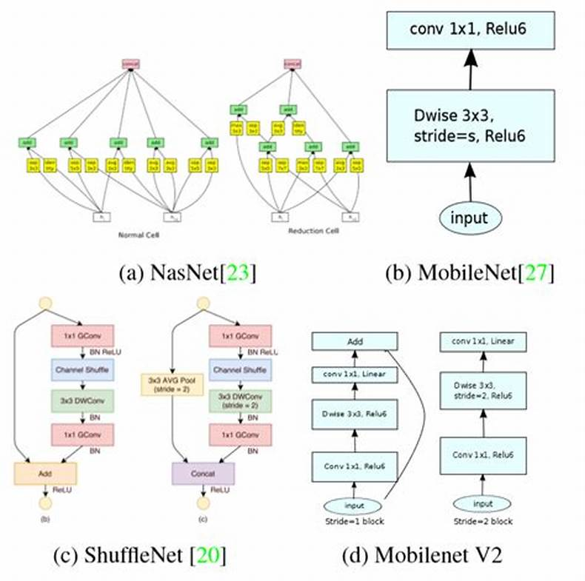
Page 2.3: Model Modifications
Feature Extraction Focus
The modifications to MobileNetV2 prioritized feature extraction over classification, enabling the AI agent to leverage convolutional layer outputs for enhanced decision-making in the Flappy Bird environment, crucial for effective reinforcement learning.

Slide 10
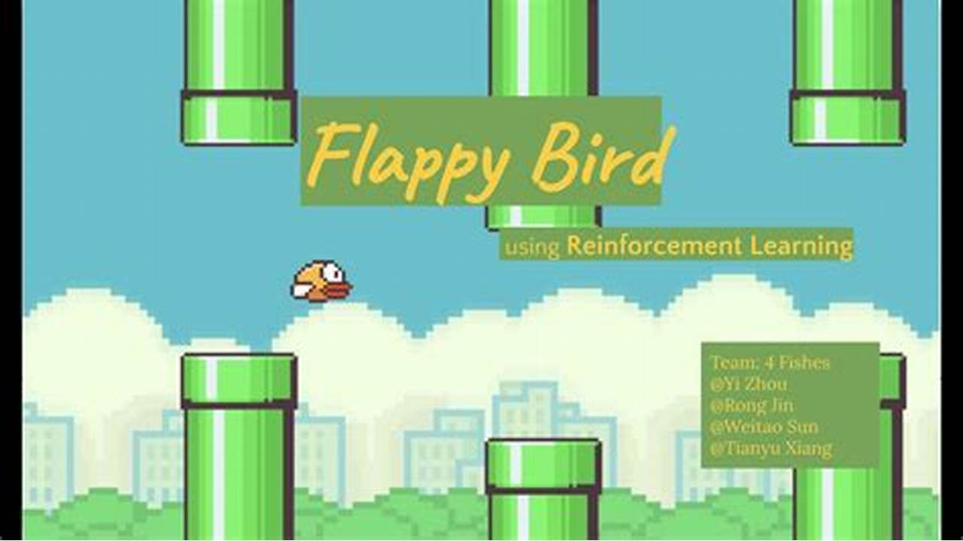
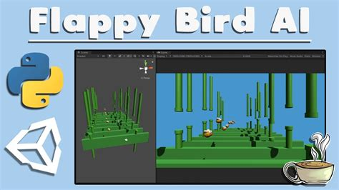
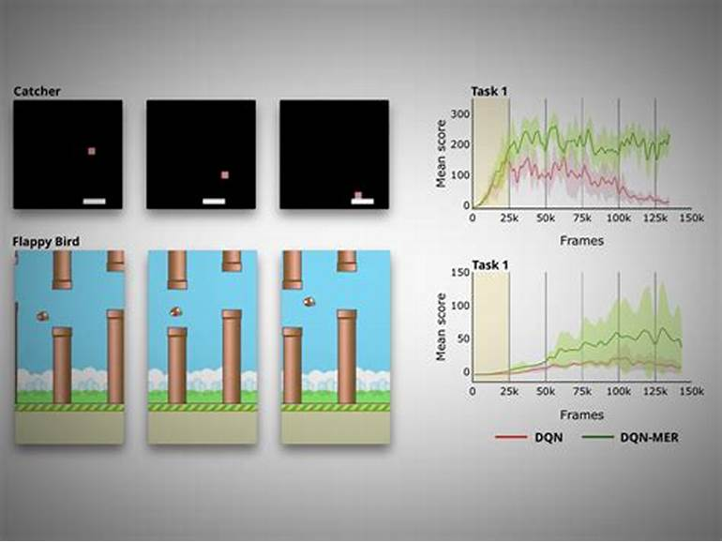
Page 2.4: Challenges Faced
01
02
03
Vision Model Adaptation
Action Mapping Complexity
Resource Management Issues
Adapting MobileNetV2's vision features for reinforcement learning required significant architectural changes to align feature outputs with the discrete action requirements of Flappy Bird gameplay.
Translating the continuous outputs of the CNN into discrete actions necessitated the development of a robust policy, ensuring effective decision-making for the AI agent during gameplay.
The computational demands of integrating deep learning with reinforcement learning led to challenges in resource allocation, necessitating optimization techniques to balance model complexity and training efficiency.

Slide 11
Section 3
Reinforcement Learning

Slide 12


Page 3.1: Key Concepts
State Representation Significance
Policy Optimization Techniques
Accurate state representation is crucial for the agent's decision-making process, as it directly influences the effectiveness of the learning algorithm and the agent's performance in the game.
Employing advanced techniques such as Q-learning and policy gradients enhances the agent's ability to learn optimal actions, thereby maximizing cumulative rewards and improving gameplay efficiency.

Slide 13




Page 3.2: Algorithm Overview
03
DQN Mechanism Overview
Experience Replay Importance
Target Network Functionality
Deep Q-Learning utilizes a Q-network to approximate action values, enhancing decision-making through deep neural networks tailored for discrete action environments like Flappy Bird.
Replay memory stores past experiences, allowing the agent to learn from diverse interactions, which stabilizes training and improves convergence in reinforcement learning.
The target network maintains separate weights updated less frequently, preventing oscillations in Q-value estimates and ensuring a more stable learning process during training iterations.

Slide 14

Page 3.3: Components of DQN
Replay Memory Benefits
Experience replay enhances learning stability by allowing random sampling of past experiences, improving generalization.
Q-Network Functionality
Target Network Stability
The Q-network approximates Q-values using deep learning, enabling effective action-value predictions in complex environments.
The target network reduces Q-value fluctuations by providing consistent updates, promoting robust convergence during training.

Slide 15
Section 4
Training Process

Slide 16
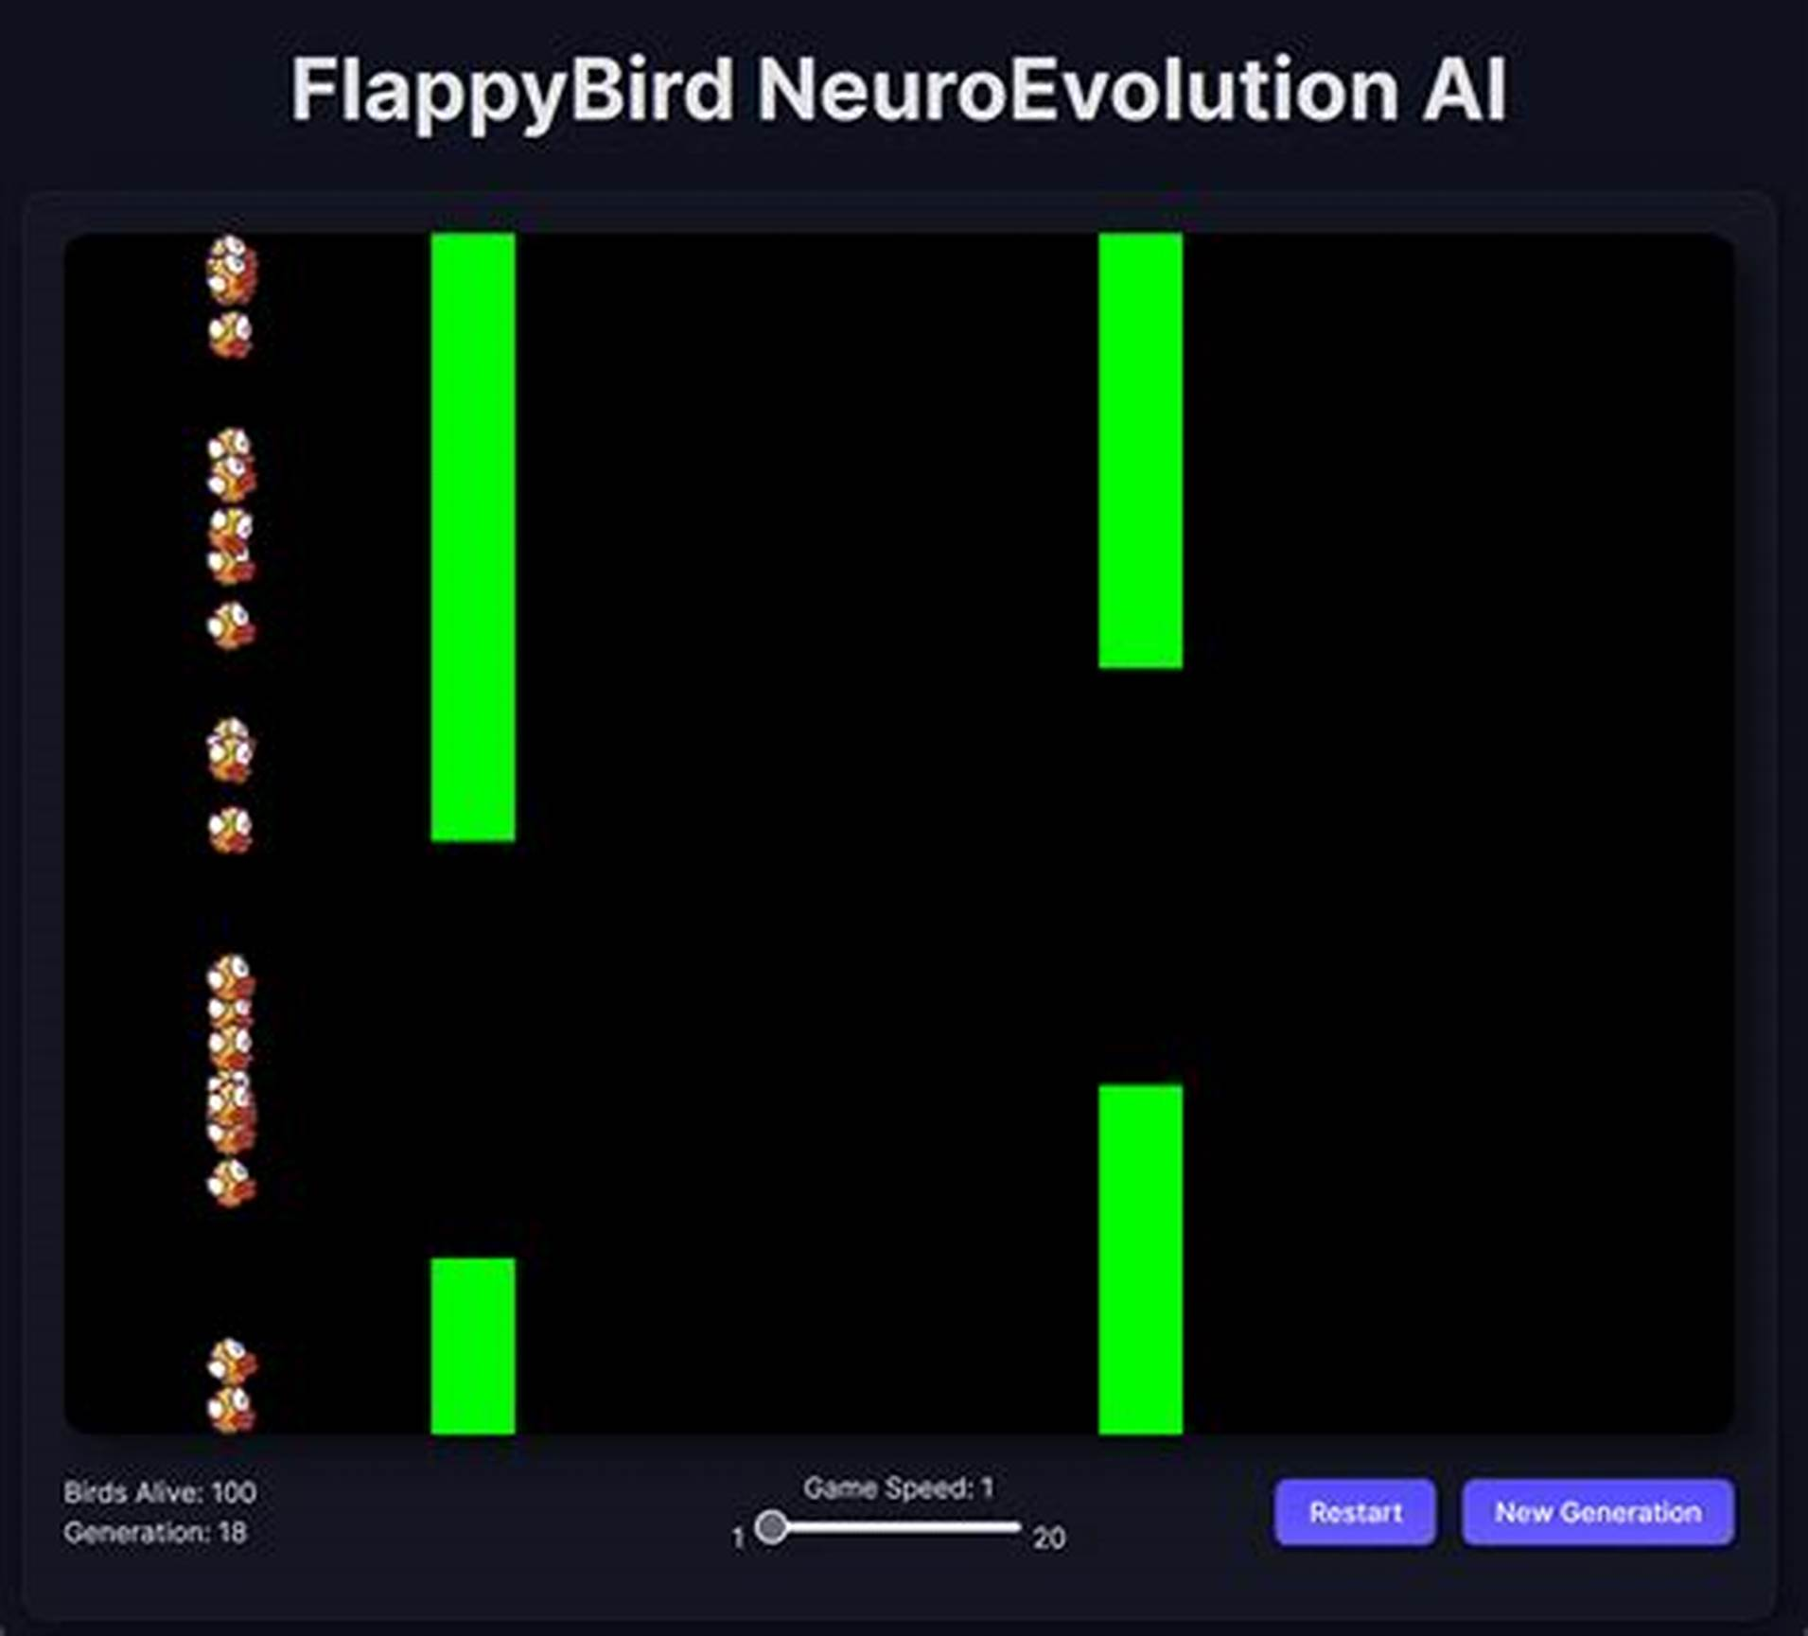
Page 4.1: Step-by-Step Process
Iterative Learning Framework
The training process is iterative, allowing the AI agent to refine its strategies through repeated gameplay episodes, enhancing its adaptability to complex scenarios and optimizing performance based on accumulated experiences and feedback.

Slide 17
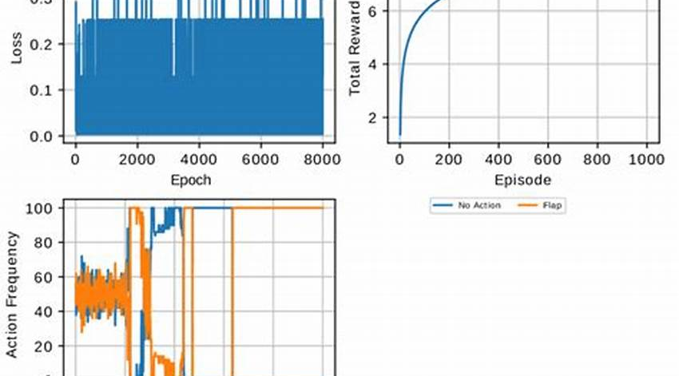


Page 4.2: Key Hyperparameters
Learning Rate Impact
Epsilon Decay Strategy
Discount Factor Selection
The learning rate significantly influences the convergence speed of the DQN algorithm, necessitating careful tuning to balance rapid learning with stability to avoid divergence during training.
Implementing an effective epsilon decay strategy is crucial for balancing exploration and exploitation, allowing the agent to initially explore diverse actions before focusing on optimizing learned behaviors.
Choosing an appropriate discount factor is essential, as it affects the agent's prioritization of immediate versus future rewards, shaping its long-term strategy and overall performance in gameplay.

Slide 18


Page 4.3: Common Issues
01 .
02 .
Catastrophic Forgetting Impact
Sparse Rewards Challenge
Catastrophic forgetting can severely limit an AI agent's ability to retain previously learned strategies, leading to performance declines as it adapts to new challenges in Flappy Bird.
Sparse rewards complicate the learning process, as infrequent feedback can hinder the agent's ability to associate actions with outcomes, prolonging training and resource consumption.

Slide 19
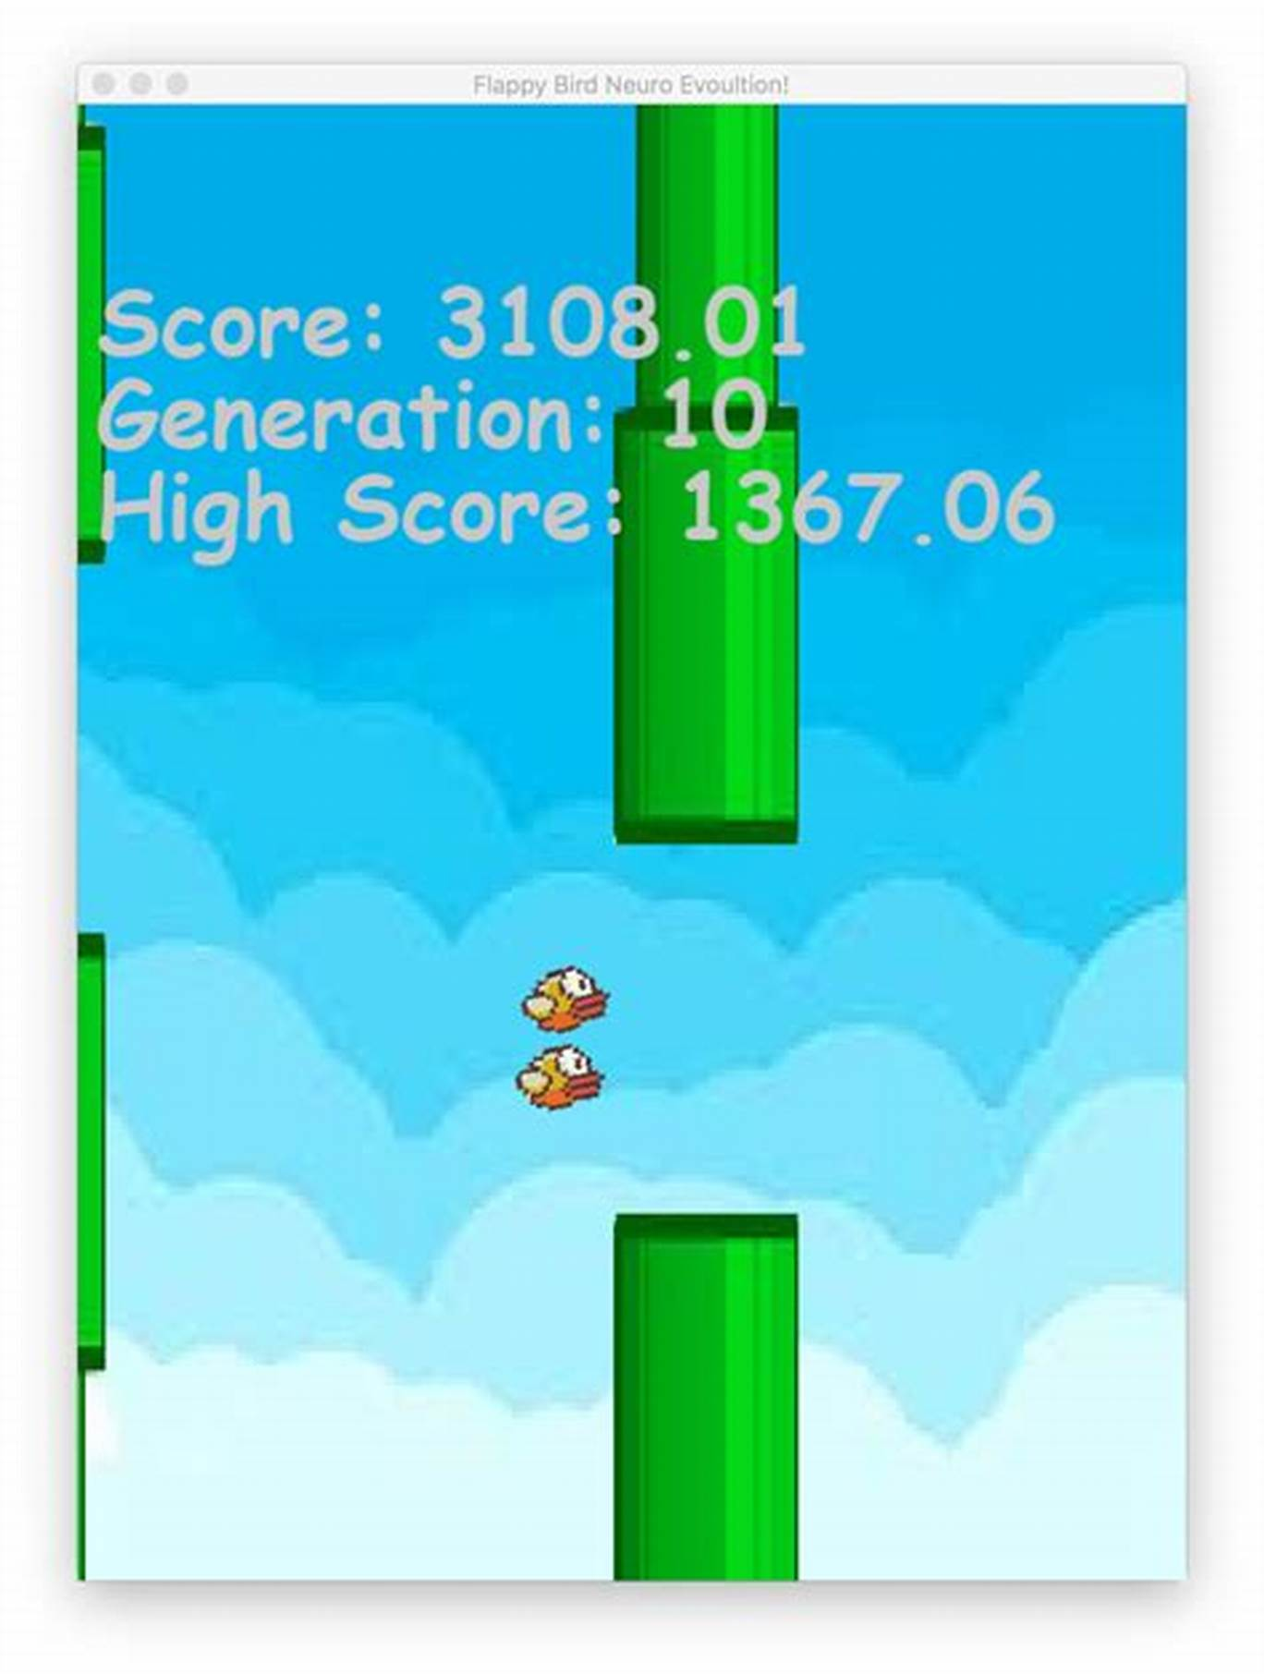





Page 4.4: Solutions Implemented
Experience Replay Implementation
Utilized to prevent catastrophic forgetting by diversifying training data through past experience sampling.
Target Network Stability
Managed update frequency to reduce oscillations, ensuring consistent learning dynamics during training.
Reward Structure Enhancement
Improved reward feedback mechanisms to facilitate better learning from sparse rewards in gameplay.

Slide 20
Section 5
Testing & Evaluation

Slide 21

Page 5.1: Evaluation Metrics
Comprehensive Performance Assessment
Benchmarking Progress
Evaluation metrics provide a structured framework for analyzing the AI agent's learning effectiveness and adaptability in the Flappy Bird environment.
Regular tracking of average score, survival time, and pipes passed establishes benchmarks for evaluating the AI agent's development over time.
Data-Driven Insights
Statistical analysis of metrics reveals trends and variances in performance, guiding improvements in training methodologies and agent strategies.

Slide 22





Page 5.2: Visualization Techniques
Performance Metrics Visualization
Gameplay Replay Analysis
Advanced Visualization Tools
Graphical representation of average scores and survival times aids in tracking the AI agent's learning progress and identifying areas for improvement.
Performance replay allows stakeholders to observe the AI's decision-making process, highlighting successful strategies and mistakes for further refinement.
Utilizing libraries like Matplotlib and OpenCV enhances the clarity and interactivity of visualizations, facilitating deeper insights into the AI agent's performance dynamics.

Slide 23


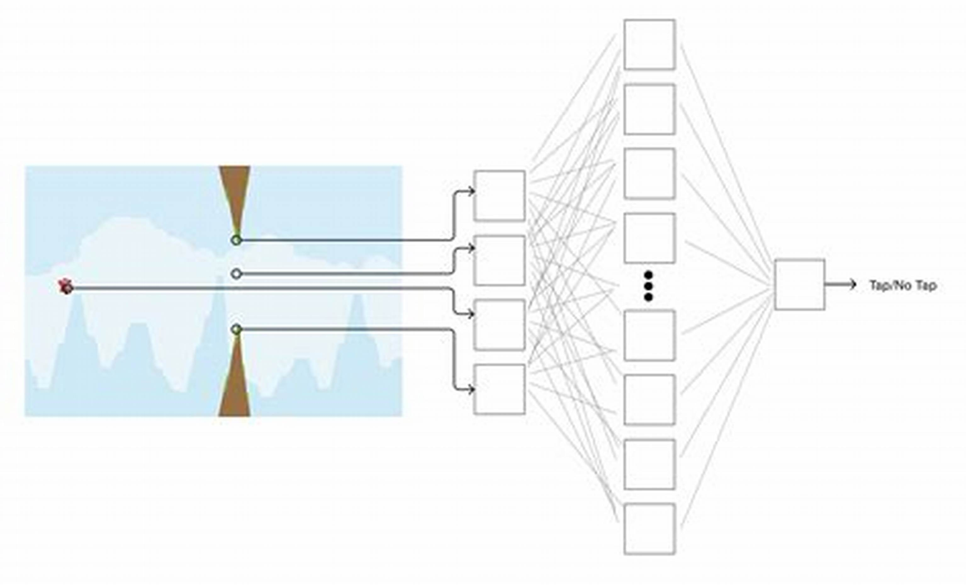
Page 5.3: Future Improvements
Enhanced Learning Efficiency
Implementing prioritized experience replay can significantly improve the AI's learning efficiency by focusing on experiences that yield the highest learning value, thus accelerating convergence to optimal strategies.
Improved State Understanding
Utilizing image segmentation techniques will allow the AI to better interpret the game environment, leading to more informed decision-making and enhanced gameplay strategies through a richer state representation.
Structured Learning Progression
Integrating curriculum learning will facilitate a gradual skill acquisition process for the AI, enabling it to master simpler tasks before tackling more complex challenges, thereby improving overall performance stability.

Slide 24
Section 6
Conclusion

Slide 25
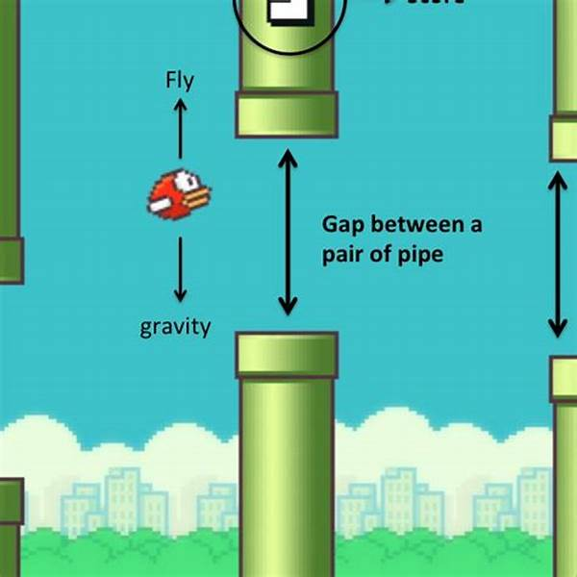
Page 6.1: Key Learnings
Reinforcement Learning Insights
The project highlights the transformative potential of reinforcement learning in gaming, demonstrating how iterative feedback mechanisms and reward structures can significantly enhance AI agent performance and adaptability in complex environments like Flappy Bird.

Slide 26
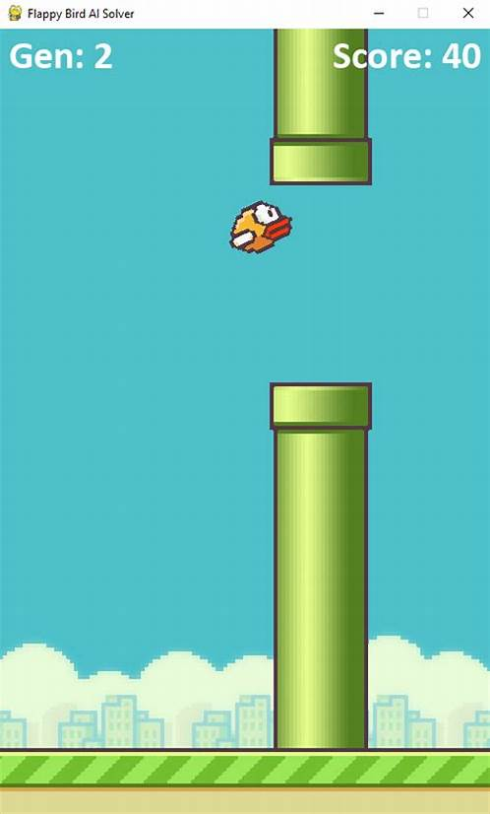
Page 6.2: Challenges Encountered
Model Adaptation Complexity
Adapting MobileNetV2 for Flappy Bird required intricate modifications to align with reinforcement learning needs.
Hyperparameter Optimization Difficulties
Tuning critical hyperparameters under time constraints complicated the training process and model performance.
Balancing Exploration and Exploitation
Ensuring effective exploration while optimizing learned behaviors posed significant challenges during agent training.

Slide 27


Page 6.3: Future Ideas
Adaptive Learning Mechanisms
02
Enhanced Multi-Agent Dynamics
01
Implementing adaptive learning mechanisms, such as dynamic reward shaping, can optimize training efficiency by tailoring feedback based on agent performance, promoting faster skill acquisition and improved gameplay outcomes.
Exploring advanced multi-agent dynamics could lead to emergent behaviors, fostering collaboration and competition among AI agents, ultimately enhancing their strategic capabilities in complex gaming scenarios.

Slide 28

Thank You
Contact: 281-779-1109

